Slide 1

Deep Gradient Compression:
Reducing the Communication Bandwidth for Distributed Training
Yujun Lin, Song Han, Huizi Mao,
Yu Wang, William J. Dally
Justin Chen
Nov. 21, 2017

Slide 2


Distributed Training
Commutative and Associative Laws of Addition
Distributed gradient computation across worker nodes

Slide 3



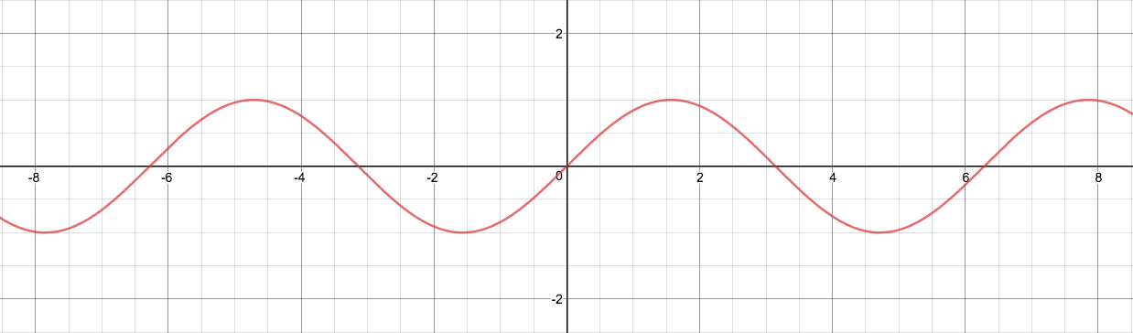

Gradient Quantization
Quantization function (quantizer) converts to a lower-precision representation
11
10
01
00
e.g. 2-bit resolution quantization over

Slide 4
Varying Resolutions
https://www.desmos.com/calculator/kdtllrvb50

Slide 5
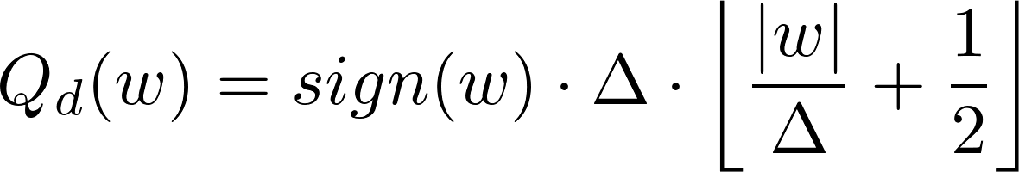
Deterministic Rounding (R)
Vector
+/-
Quantized
vector
Resolution/Quantization step: constant factor which is the smallest positive number that is representable

Slide 6

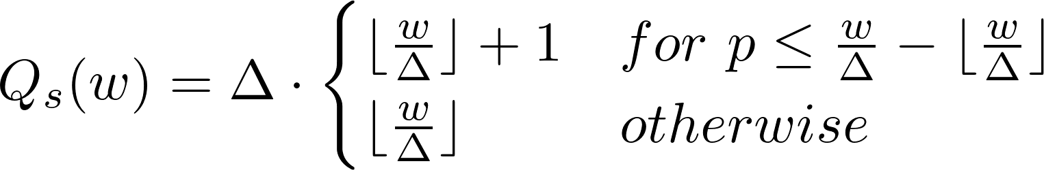

Stochastic Rounding (SR)
Uniformly random

Slide 7
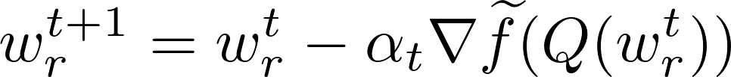

BinaryConnect (BC)

Slide 8


Deep Gradient Compression (DGC)
Momentum Correction
Local Gradient Clipping
Momentum Factor Masking
Warm-up
Training

Slide 9
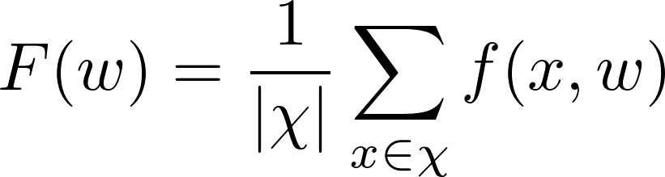
Insight from SSGD
Loss function
Average training loss
Training set
Parameter vector

Slide 10
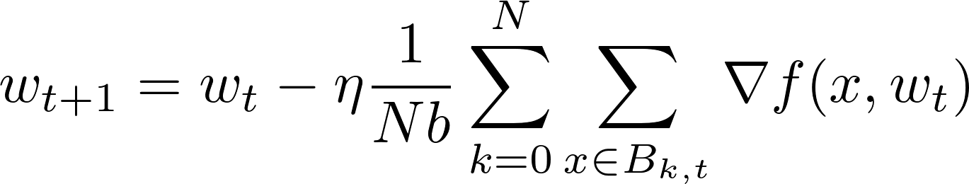

Insight from SSGD
N worker nodes
Sequence of N minibatches sampled from training set each of size b at iteration t
Minibatch size

Slide 11
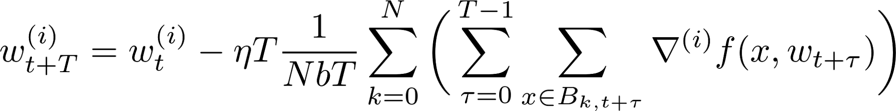

Insight from SSGD
Local gradient accumulation considered as increasing batch size from Nb to NbT
Sparse Update Interval
Scaled learning rate
Minibatch size
Sum over T iterations
Sum of gradients over minibatch on iteration

Slide 12

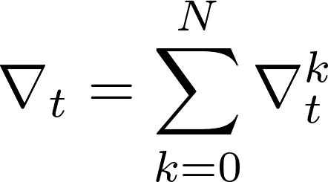
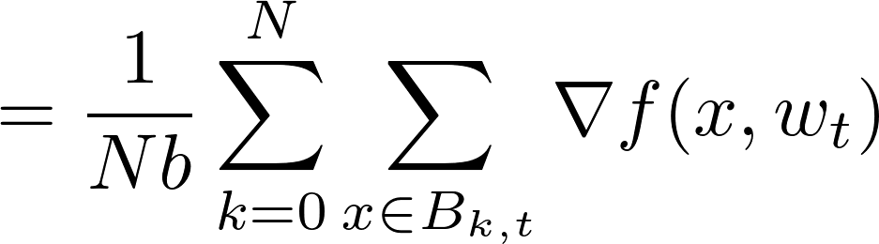
SGD using Momentum

Slide 13
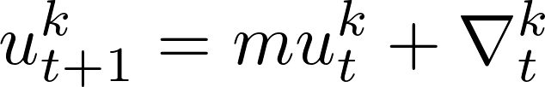
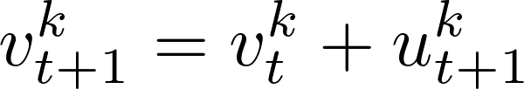
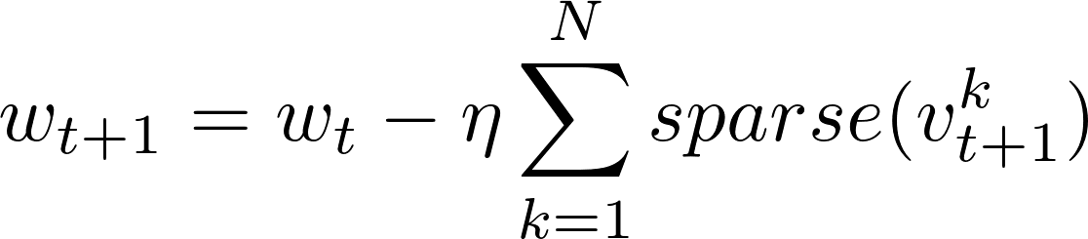
DGC SGD using Momentum Correction

Slide 14
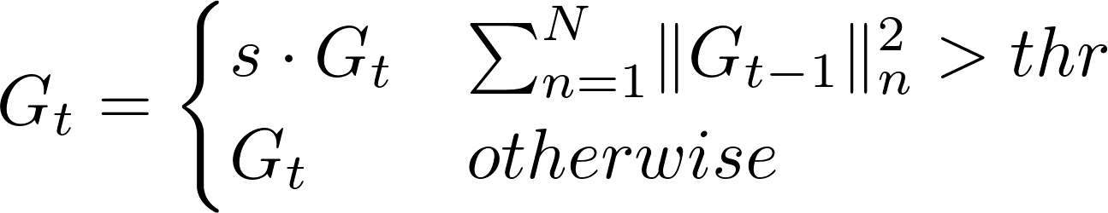
Local Gradient Clipping

Slide 15
Momentum Factor Masking
Alleviates staleness
Apply mask to both gradients and momentum factor
Prevents stale momentum

Slide 16
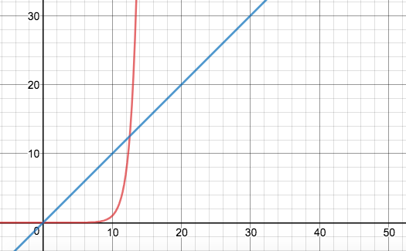
Warm-up Training
Early training is unstable
Warm-up period:
Smaller learning rate - slows down rate of parameter change
Denser gradients - reduce extreme updates from delayer gradients
Exponentially increase gradient sparsity
Warm-up

Slide 17
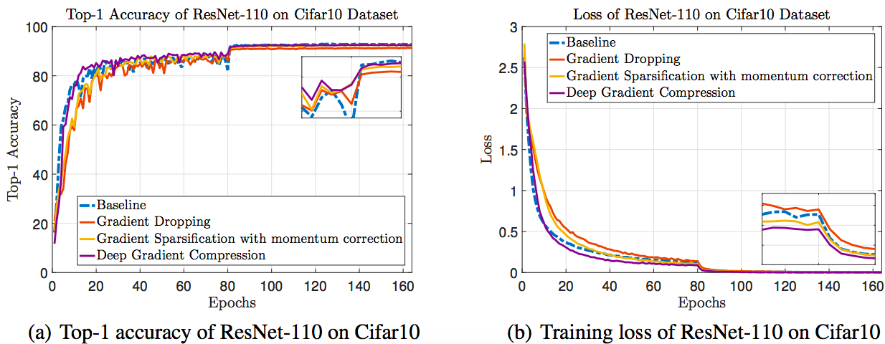
Image Classification with 99.9% Gradient Sparsity

Slide 18
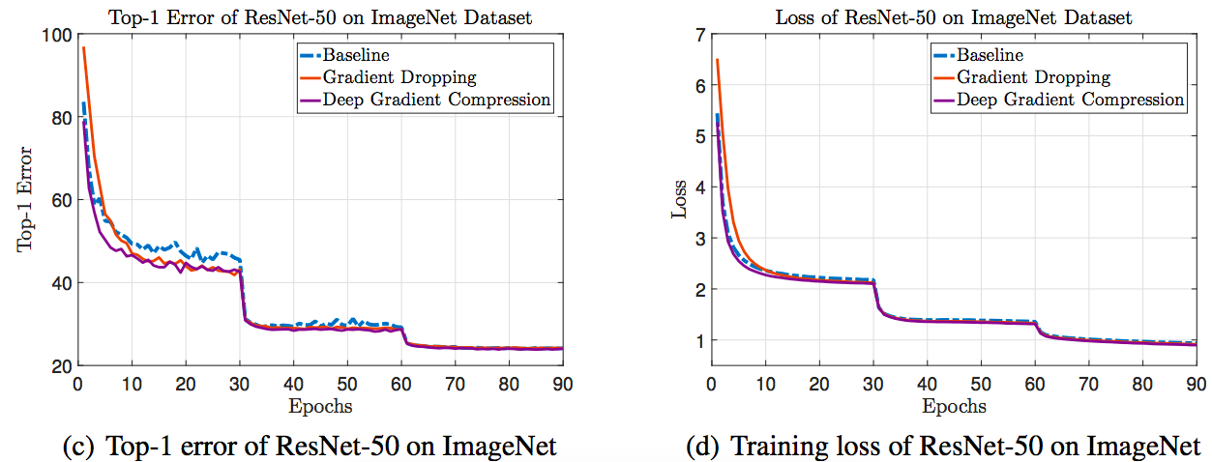
Image Classification with 99.9% Gradient Sparsity

Slide 19
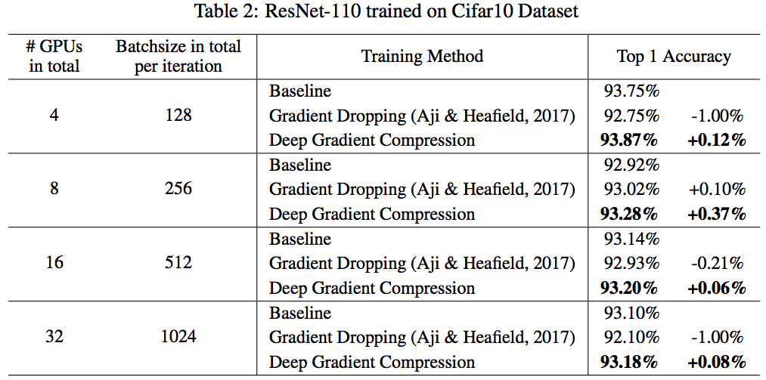

Slide 20
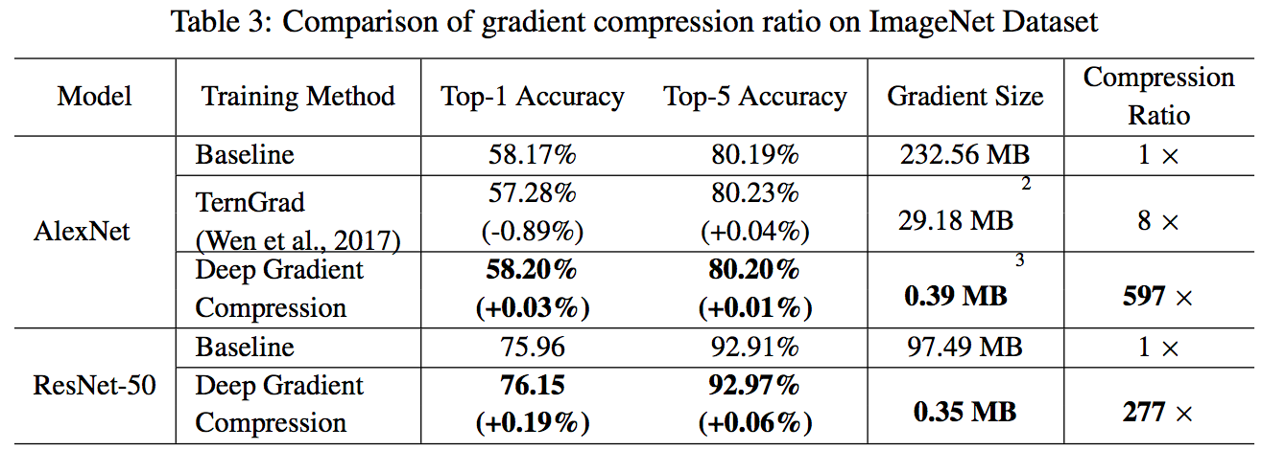

Slide 21
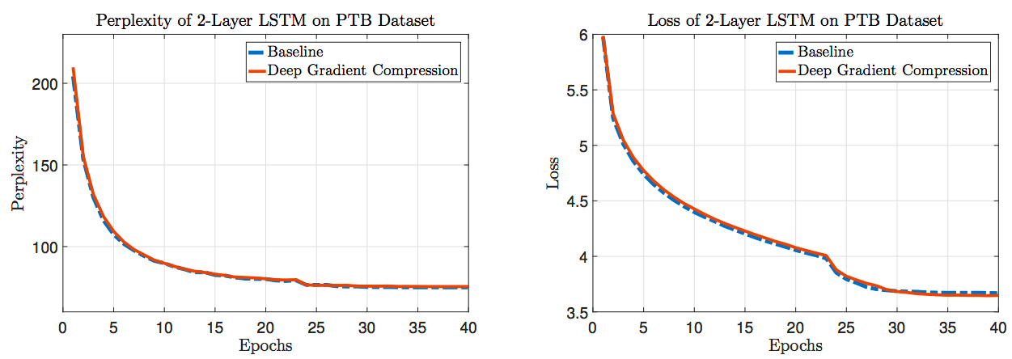
Next Word Prediction with 99.9% Gradient Sparsity

Slide 22
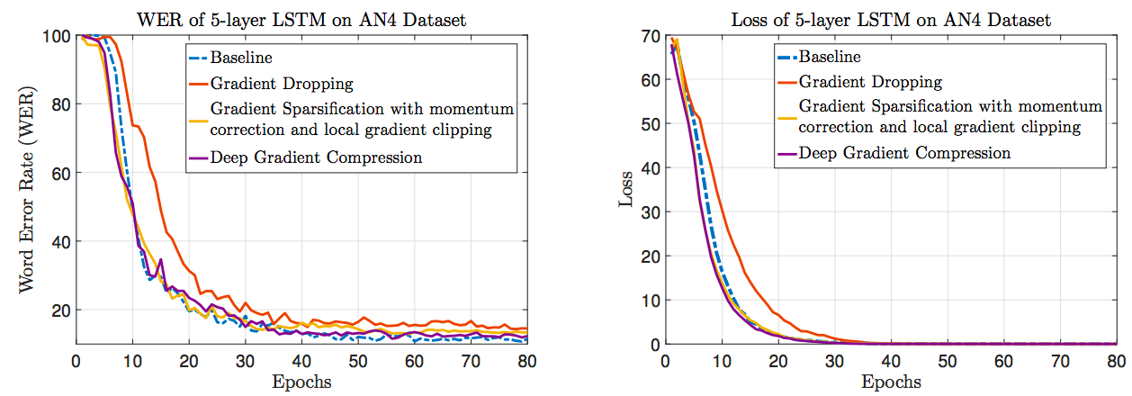
Speech Recognition with 99.9% Gradient Sparsity

Slide 23
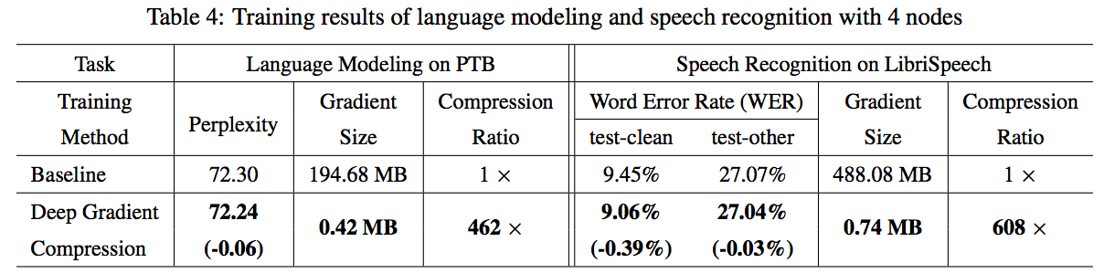
LSTM Models with 99.9% Gradient Sparsity

Slide 24
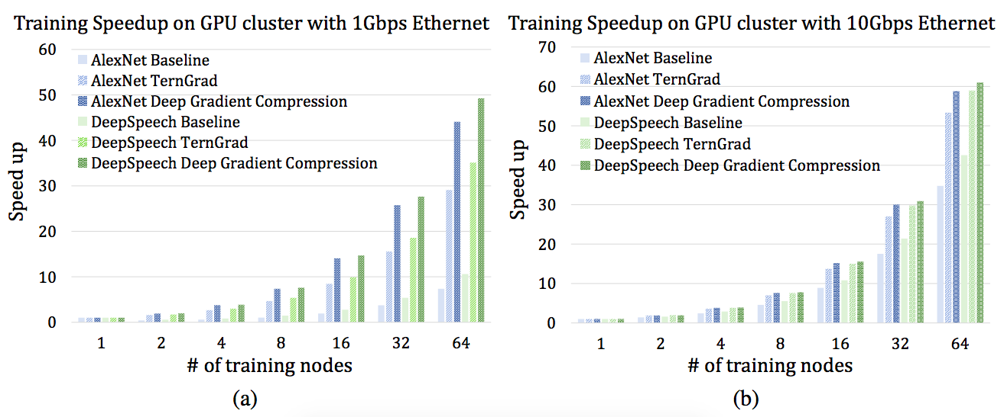
Speedup and Scalability of Distributed Training

Slide 25
References and Further Reading
Deep Gradient Compression: Reducing the Communication Bandwidth for Distributed Training
Sun, Xu, et al. "meprop: Sparsified back propagation for accelerated deep learning with reduced overfitting." arXiv preprint arXiv:1706.06197 (2017).
Wen, Wei, et al. "TernGrad: Ternary Gradients to Reduce Communication in Distributed Deep Learning." arXiv preprint arXiv:1705.07878 (2017).
You, Yang, et al. "ImageNet Training in Minutes." arXiv preprint arXiv:1709.05011 (2017).
Li, Hao, et al. "Training Quantized Nets: A Deeper Understanding." arXiv preprint arXiv:1706.02379 (2017).

